Slide 1
A GREEN TOWN
citizenship

Slide 2
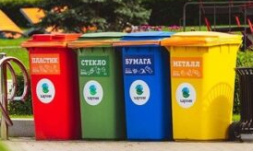
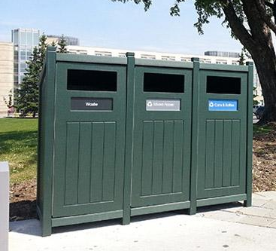
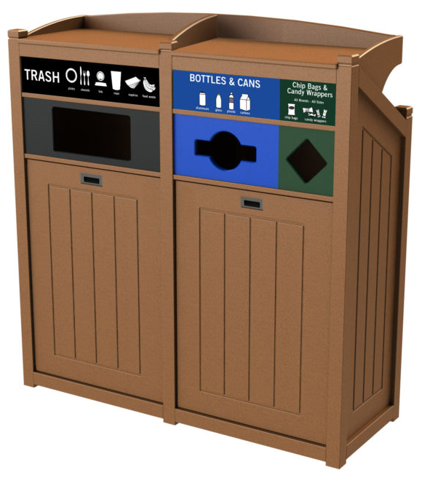
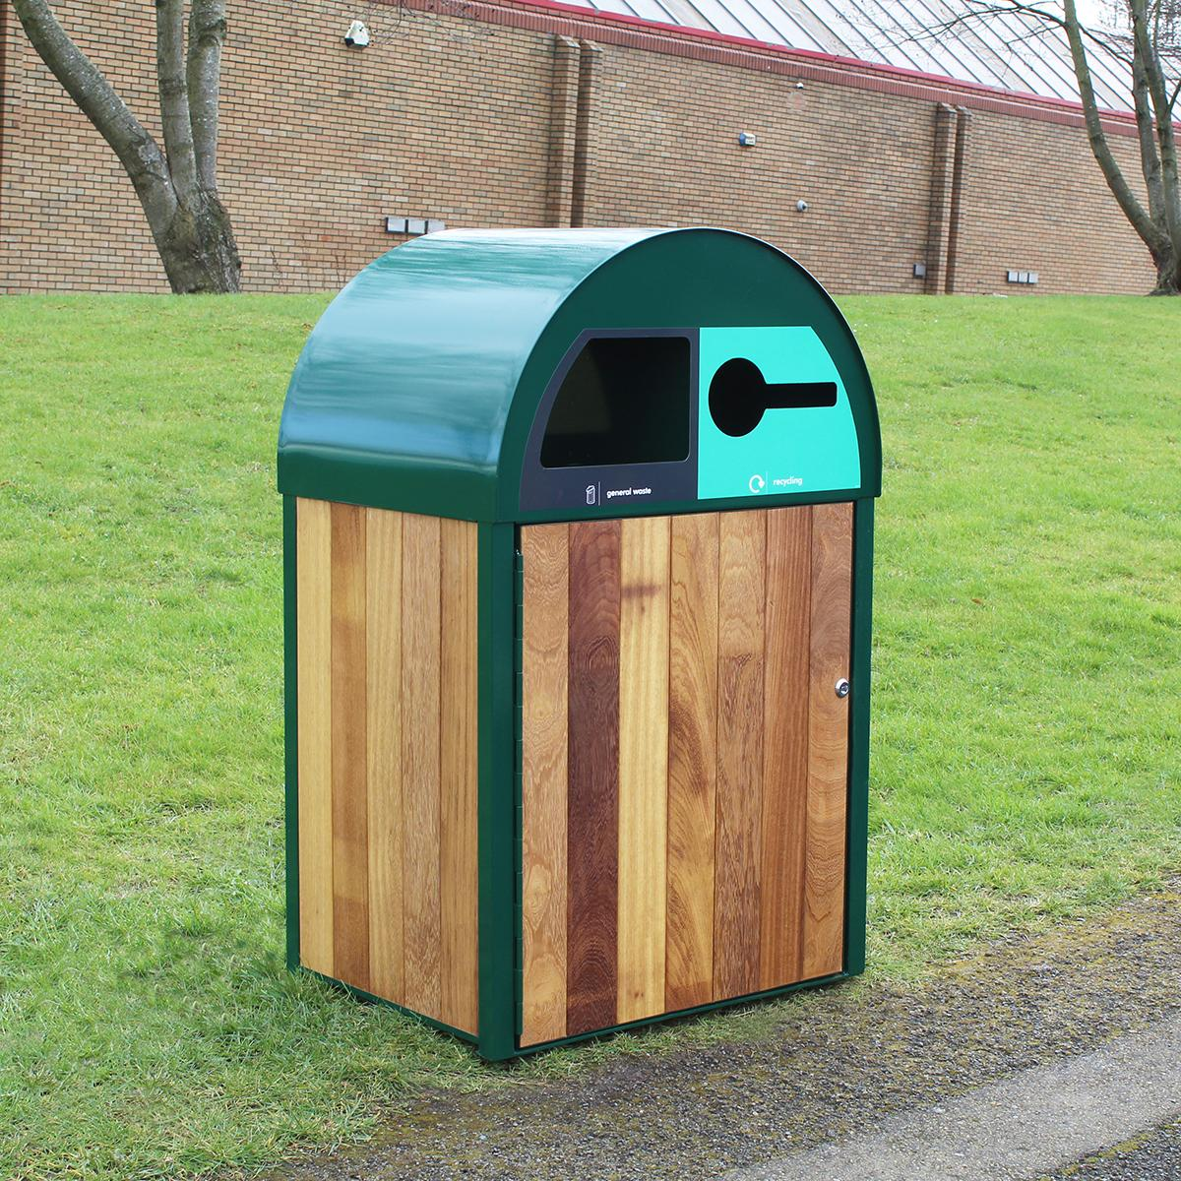
RECYCLING BINS

Slide 3
Survey- what we found
We asked 7 students from year 7 their opinions on recycling bins in eye.
All of the responses agreed that there is currently not enough accessible recycling bin, with most of them also agreeing that the few we have are not accessible enough. The only places you can currently recycle in eye are people’s personal home recycling bins, which just arn’t practical when you are not at home.
We also asked them where they felt that the bin would be most practical and most of the responses said that they wanted more in parks and outside areas so they can recycle food packaging and bottles when they are with their friends and would like some food.

Slide 4
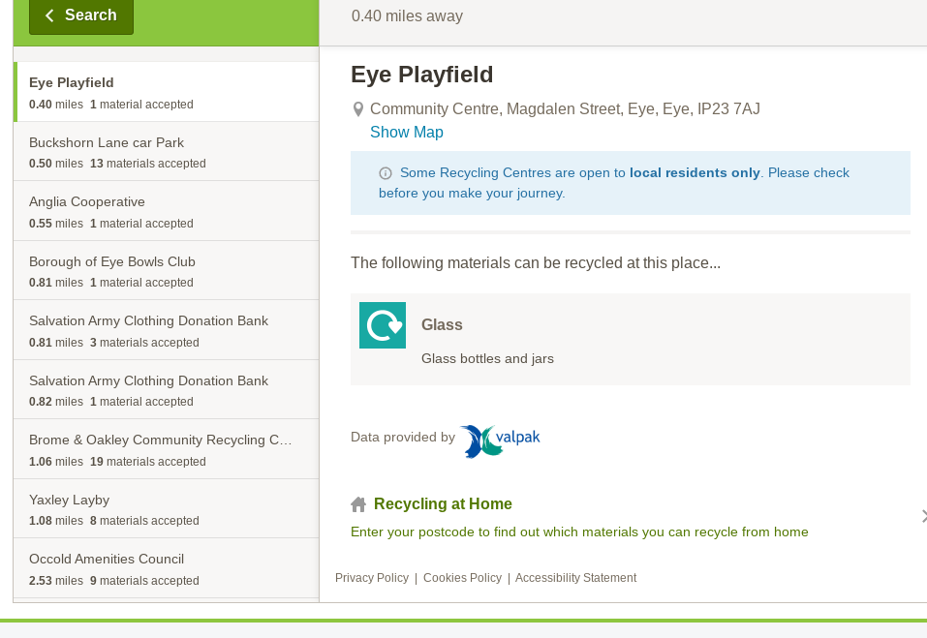

Slide 5
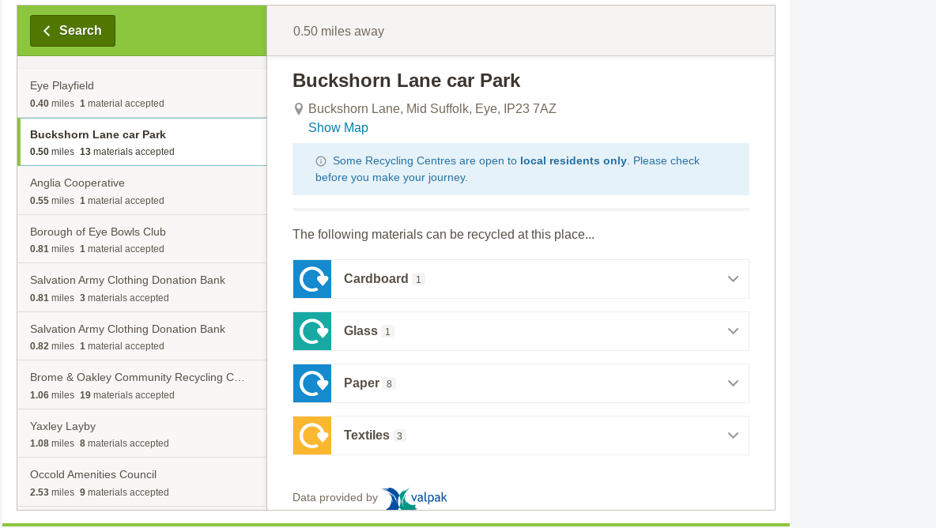

Slide 6
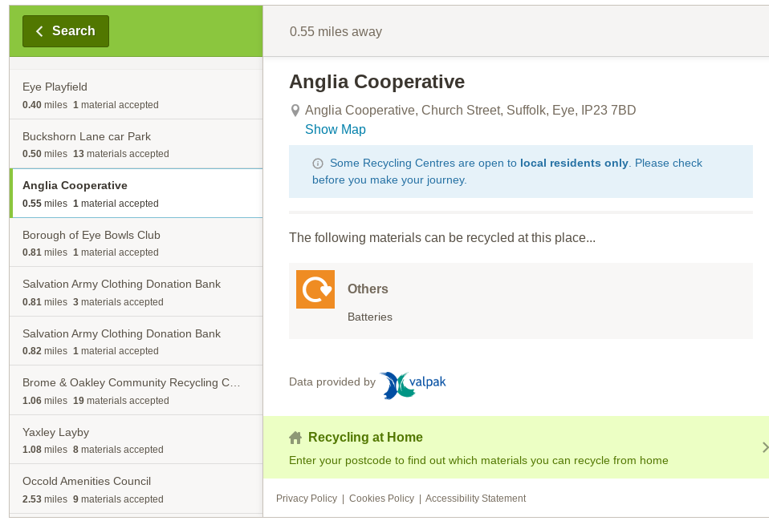

Slide 7
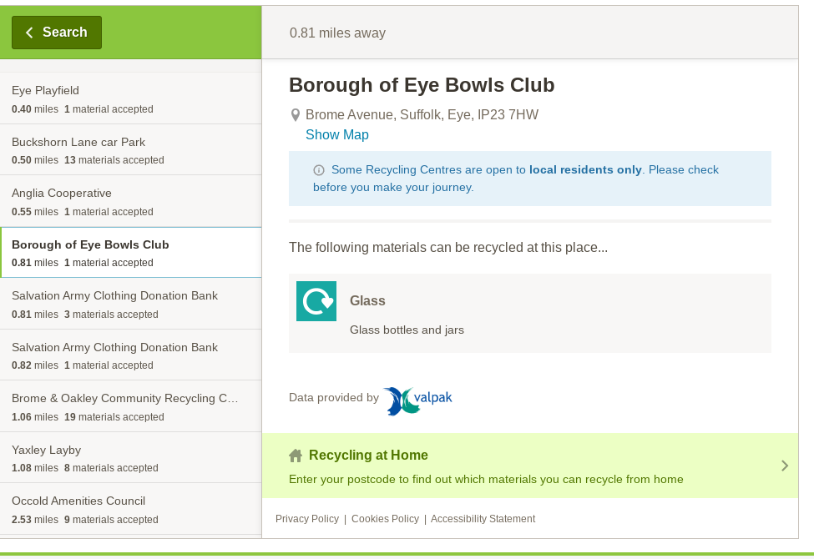

Slide 8
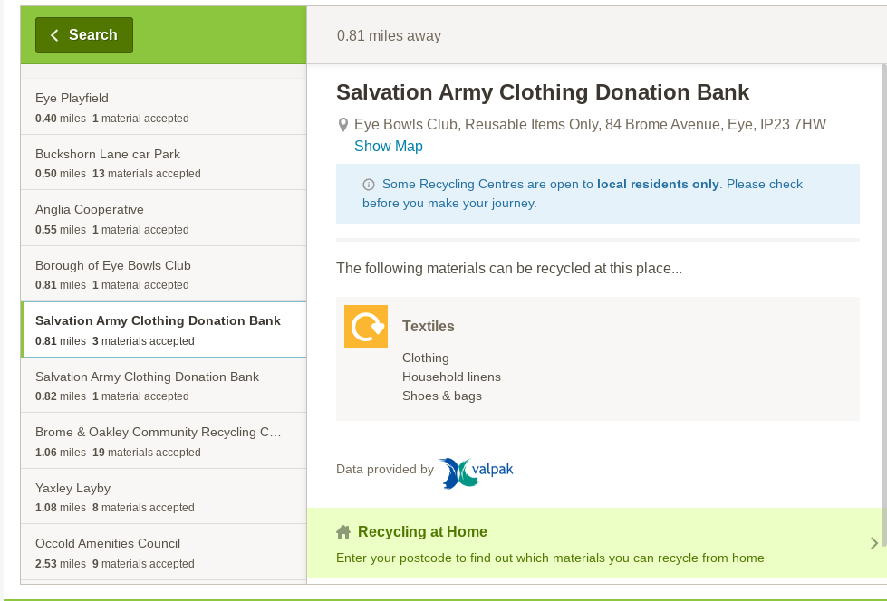

Slide 9
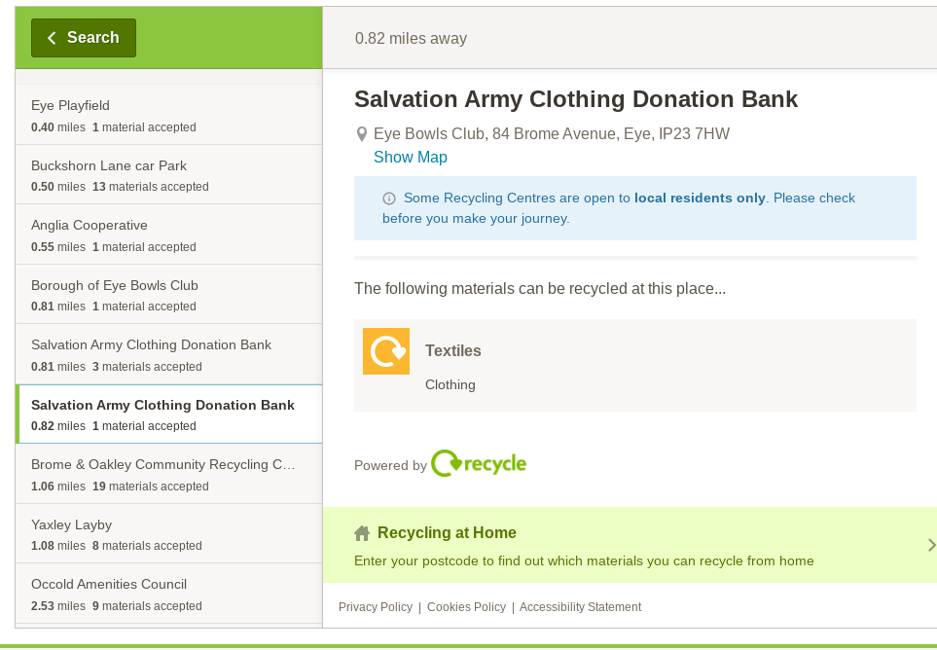

Slide 10
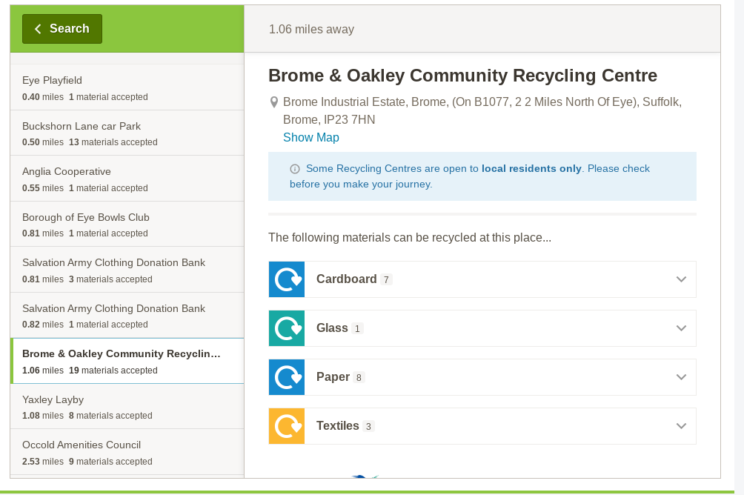

Slide 11
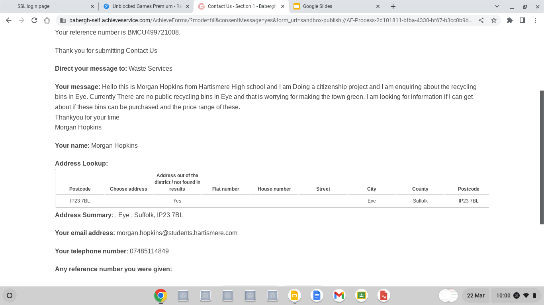

Slide 12
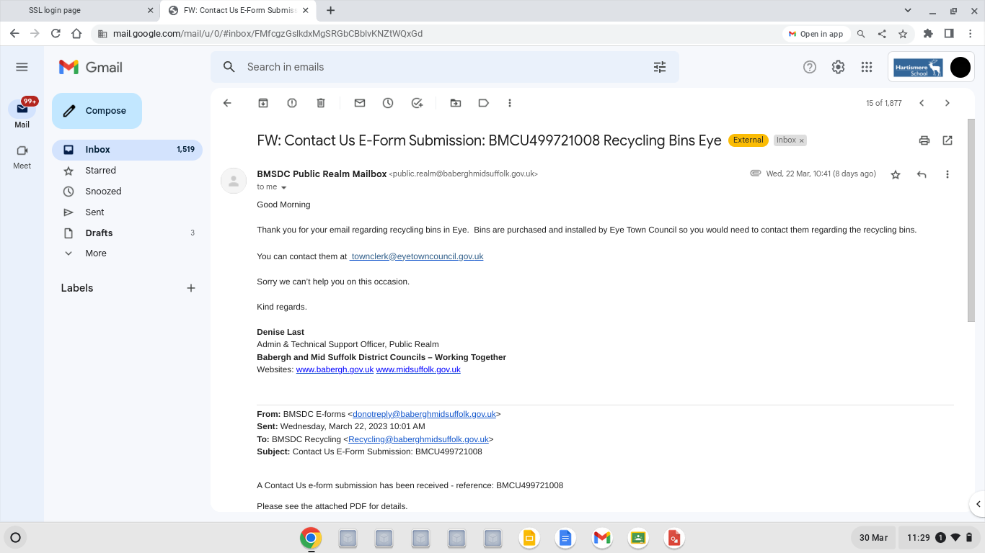

Slide 13
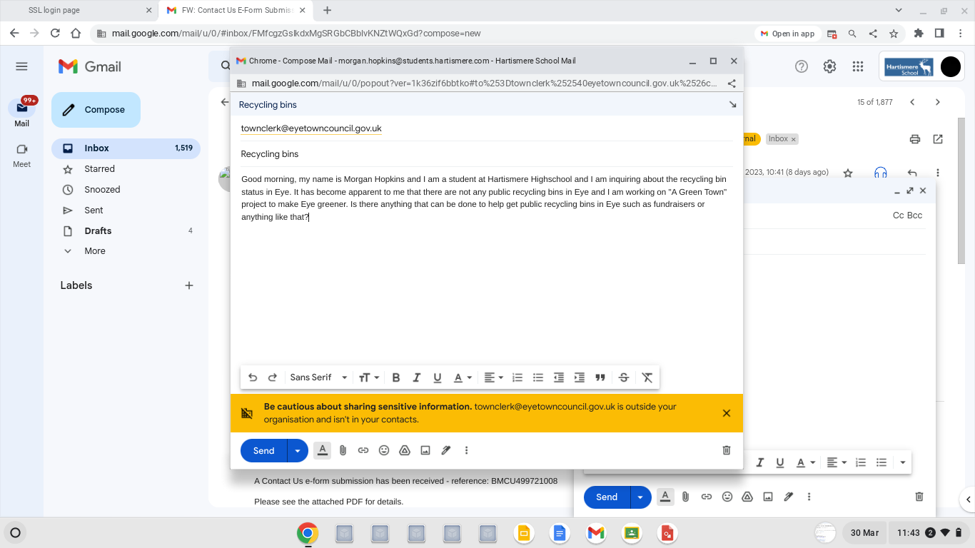

Slide 14
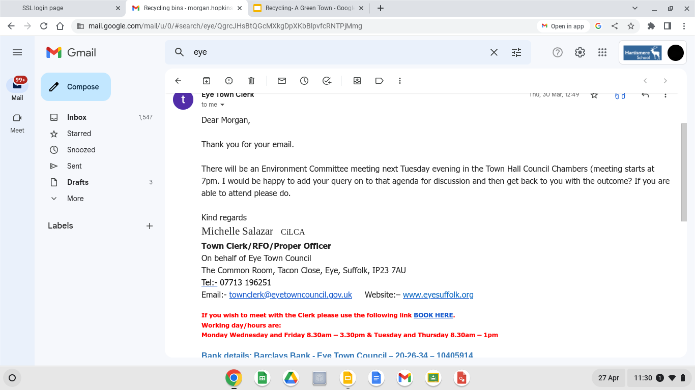

Slide 15
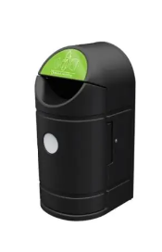
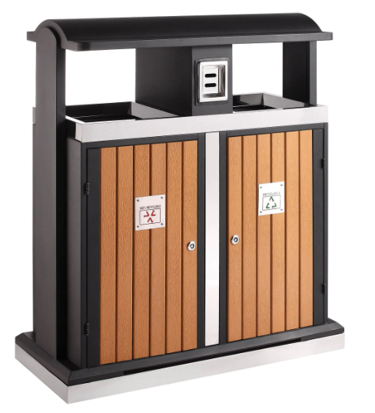
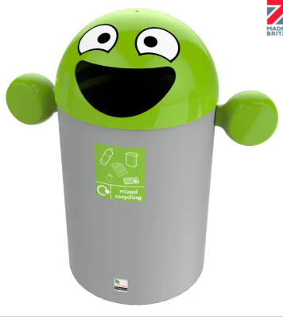
The recycling bin option ideas we presented in our proposal to eye town council:
All from Litterbins.co.uk
Exeo External Recycling bin - 90 litres £319.95
External 2 Compartment Recycling Bin - 100 Litre £659.95
Best Buddy Recycling bin - 84 litre £164.95

Slide 16
fundraising
To help pay for the bin we will do a fundraiser in school as well as asking the council for money.

