Slide 1
An Attractive Town
Active Citizenship Project

Slide 2
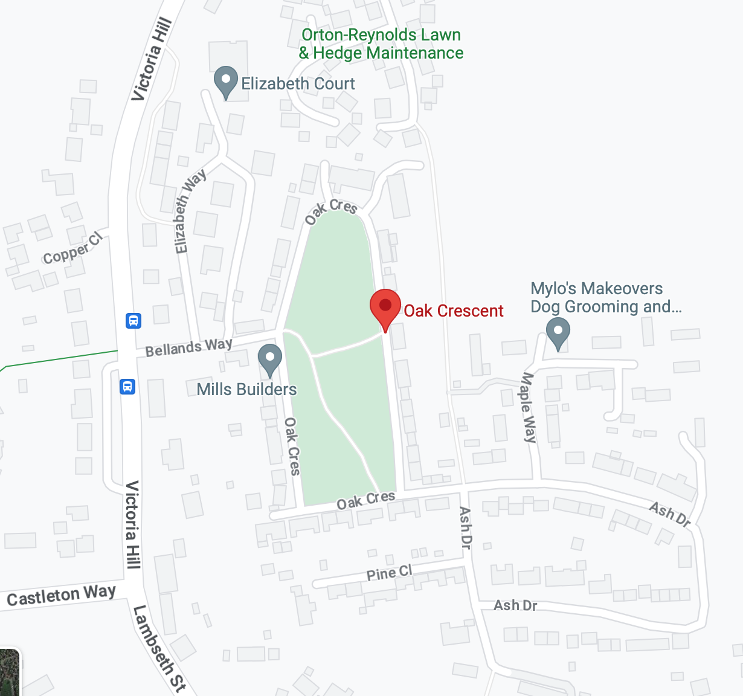
Our Proposal
We propose to plant a variety of native flowers in Oak Crescent Park, Eye. We believe that this would be a significant step towards making Eye a more attractive town. We will raise money for this by holding a fundraising event at our school and collecting donations from members of staff and family. We will plant the flowers ourselves.

Slide 3
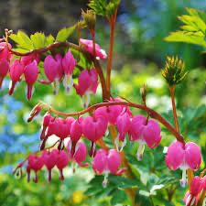
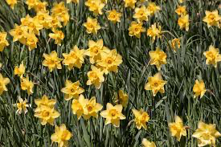
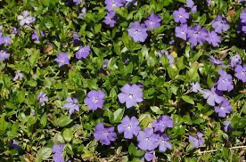
Our Research
Our research has shown that Eye is a popular town but, in general, people think that planting flowers would make it more attractive. We gathered information regarding public opinion through a questionnaire which was completed by people who live in Eye and the surrounding area. The results from the questionnaire were perhaps unsurprising but demonstrated that our sample group strongly believed adding flowers, greenery and colour would make Eye more beautiful and appealing to visitors and inhabitants. Some of the suggestions for flowers we could plant were daffodils, roses, periwinkles, bleeding hearts and generally brightly coloured plants. Essentially native plants which will thrive in the British climate.

Slide 4
The Town Plan
Section 6, figure 7.9 of the town plan notes the ‘importance of biodiversity and view to retain character of town’ also stating that ‘linking green spaces together to meet human and wildlife needs’ was an important consideration for the town.
In Section 6, figure 7.8, the town plan also explains the ‘particular local significance’ of Eye due to its ‘tranquility or richness of its wildlife’. This is something we want to maintain and even improve. As young people we feel passionately about sustainability and the importance of providing habitats for wildlife and planting which takes into consideration pollinators which are essential for biodiversity.

Slide 5
The Positive Impacts of Wildflowers
Scientific research has shown that wildflowers have a massive positive impact on our wellbeing. Spending time in beautiful, wild surroundings is a proven antidote to the stresses of modern life.
Whilst bringing a burst of colour into people's everyday lives wildflowers also help us to maintain a healthy ecosystem supporting essential microorganisms which keep soil rich in minerals and nutrients. The root systems of plants also support the soils they grow in and keep them stable in the face of heavy rainfall.

Slide 6
Our Support
We have spoken to Mrs Wickham, an avid gardener and a parent of a pupil at our school. She has suggested September/October would be the most opportune time to plant as we can establish bulbs to flower in the Spring and the slightly cooler, wetter weather will give any other plants a better chance of survival. Mrs Wickham has also offered to donate the necessary equipment and help us to transport it to Eye.

